Slide 1
Анализ данных
Введение. Демо 3
BI

Slide 2
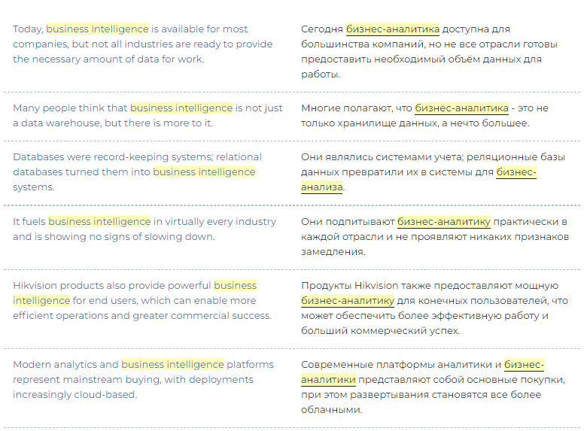
Термины и определения
Business Intelligence (BI) – деловая разведка?
Analytics
Бизнес-анализ
Разницу не могут чётко сформулировать даже эксперты. Усугубляет проблемы “удачный” перевод

Slide 3
Если нет чёткого определения попробуем найти разницу в поведении
BI is needed to run the business while Business Analytics are needed to change the business. – Pat Roche, Vice President of Engineering at Magnitude Software
BI is looking in the rearview mirror and using historical data. BA is looking in front of you to see what is going to happen. – Mark van Rijmenam, CEO / Founder at BigData-Startups
What’s the difference between Business Analytics and Business Intelligence? The correct answer is: everybody has an opinion, but nobody knows, and you shouldn’t care.” – Timo Elliot, Innovation Evangelist at SAP

Slide 4
Попробуем отделить
Business intelligence (BI) – Deals with what happened in the past and how it happened leading up to the present moment. It identifies big trends and patterns without digging too much into the why’s or predicting what will happen next.
Business analytics (BA) – Deals with the why’s of what happened in the past. It breaks down contributing factors and causality. It also uses these why’s to make predictions of what will happen in the future

Slide 5
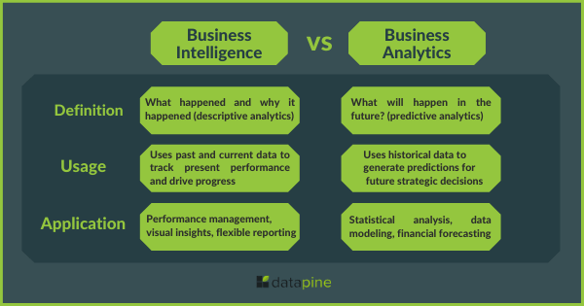
Как это видят специалисты

Slide 6
Приложения
BI applications:
Performance management: BI tools collect information on customer behaviors, conversion rates, sales, and more. It tracks performance based on general goals, allowing organizations to spot improvement opportunities to grow.
Visual insights: Thanks to modern data visualizations, organizations can monitor productivity and spot trends in an interactive way. BI dashboards, offer the possibility to filter the data all in one screen to extract deeper conclusions.
Flexible reporting: BI also offers the possibility to gather large amounts of data from various sources into one single location. These reports can be shared in various formats, enhancing communication between different stakeholders.
BA applications:
Statistical analysis: By using different statistical methods such as linear regressions, classification, and clustering to make forecasts, analysts can further understand buying behaviors and plan successful strategies.
Data modeling: Marketers or analysts can use data modeling to assess the success of marketing campaigns and find improvement opportunities. For example, by analyzing behavioral data, you can predict lead’s likelihood of moving down the funnel from awareness to purchase.
Financial forecasting: By using predictive analytics to analyze previous financial statements, BA allows you to project sales, revenue, and expenses to ensure healthy finances

Slide 7
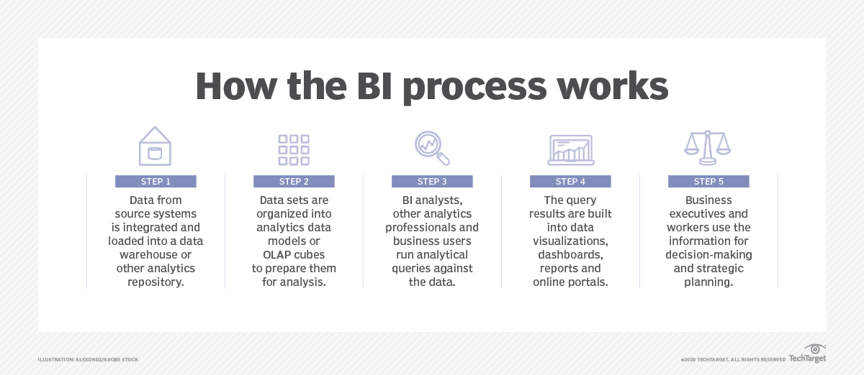
Процесс BI

Slide 8
Специализации BI
Ad hoc analysis – оперативный анализ.
Online analytical processing (OLAP)
Real-time BI (real time analytics)
Operational intelligence BI – BI для поддержки производства
Mobile BI
Software-as-a-service BI

